Slide 1
All Your Database Are Belong To Us
A bottom up, interactive learning spree
by
Jess Stanton
@tiny_mouse
February 27, 2014
wifi: uberguest
Notes:
WELCOME!
Thank Thuan, Uber and Evan.

Slide 2
Outline
Who? Roles and Permissions
Wat? Schema
How do? SQL
Python Example App
Failure Minimization
Advanced Topics
RDBMS Alternatives
Questions!

Slide 3
Disclaimer
In the scheme of things, the topic of databases and all things pertaining to them is a huge one. It is a lot to cover, so I’ll be glazing over a number of things and leaving out some others so I can cover the most commonly used or important parts.
Notes:
A lot of this will skew towards a relational sqlite or Postgres db, but there are many implementations and ways to do things.
Let’s do this thing!

Slide 4
Bedroom
Bedroom
Why this?
Closet
Bathroom
Bedroom
Office
Living Room
Kitchen
Notes:
Why it’s drawn as a cylinder in diagrams I’ll never know.
A DB is like a room in your house. It holds all of your stuff.
Mind you, this diagram is WAY off for most of San Francisco.

Slide 5

Who?
Notes:
Databases have users and roles.
They are who has access to your room and what they can do.
You can think of users as something like roommates, parents, romantic relationships, children, etc.
You can then put them into roles according to what you would let them do in your room or not.
In the case of Postgres, it comes with one user to start, the superuser.

Slide 6



My Roommates

Slide 7
Wat?
Notes:
What is data. What defines something you want to store?

Slide 8
Topography
Most Important Parts
Tables
Indexes
Additional Features
Views
Stored Procedures
Lots more...
Notes:
A DB is a collection of schema objects.
We’re going to skip a lot of the objects except to mention them in passing.
The meat of the db will be in Tables and Indexes.
Indexes are data structures containing copies of select columns from a table that aid in improving query speeds.
They are stored as a B-tree or B+-tree.
Views are a construct over one or more tables. Materialized View.
Stored procedures are pretty much functions you can call.
Maybe give examples of other types of things like enums, users etc.

Slide 9
Tables
Bedroom
Bedroom
Columns
Rows
Naming
Tables
Columns
Closet
Bathroom
Bedroom
Office
Living Room
Kitchen
Notes:
Tables are like excel spreadsheets.
Naming (plural is better than singular)
Primary Key
- DB chooses (sequence, autoincrementing) A++ would choose again
- You choose
* Terribly difficult to near impossible to find a truly unique key
* If you need to change the pkey, you have to change all the tables that have it as a foreign key.
- Composite
Joining on a non sequence based primary key gets complicated.
Under the hood a lot of db implementations make the auto-increment key anyway.
Columns
- Naming
* be consistent across all tables
* singular
* id vs tablename_id

Slide 10
Column Data Types
Strong vs. Weak Typing
Nullable vs. Not
Common Ones:
text
variable length characters (varchars)
ints
floats/reals
blob
a bunch more
Notes:
Different DBs support different types.
Text can order and has an encoding, blob is just bytes.
Things obviously missing: arrays, dictionaries/hash tables.

Slide 11
Data Types pt. 2
Non-SQLite DBs:
date (with or without timezone)
booleans
enums
Uncommon ones:
Postgres:
geospatial points/polygons
json
Notes:
If you’re going to use JSON, don’t unless you are absolutely certain you will never need to query anything inside it.
Caveat to using enum, in mysql it might still rewrite the entire table (which is expensive).
Alembic doesn’t let you alter enums.
It’s important to understand this when picking both a database as well as which specialized types you’re going to use.
It could impact your ability to change dbs if you should ever need it.

Slide 12
Primary Key
Has to be unique.
Has to be not null.

Slide 13
Your Stuff aka “items”
name
color
color family (red, orange, yellow, …, violet)
type (shirt, book, dish, tech)
storage location (kichen, living room, my room)
Notes:
This is the denormalized naive table.

Slide 14
What types are these things?
Is name an int?
How would you store color?

Slide 15
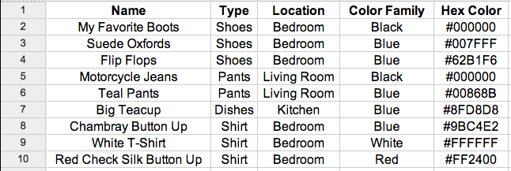
This is your “items” table

Slide 16
Can we do better?
What would happen if you misspelled ‘blue’ as ‘bule’?

Slide 17
Normalization
Minimize redundancy and dependency unless you have a good reason.

Slide 18

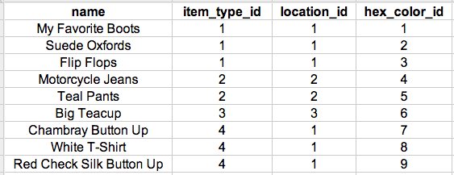
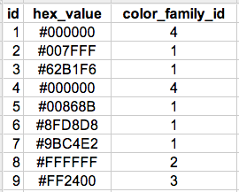


These are your tables
Notes:
FOREIGN KEYS
foreign key means column -> other table’s row. that row has to exist.
two schools of thought, treat the db as smart and advanced and expect it to do things for you, treat it as dumb.
DENORMALIZE:
Only as a last resort.
When there are strong performance impacts due to the joins for a common/frequent query.
Count data. A count query to do things like number of shirts.
This makes modifying data a lot more difficult as you have to be certain to update all the places where the data is denormalized.

Slide 19
How?

Slide 20
OH CRUD
SQL
DDL: CREATE, ALTER, RENAME, TRUNCATE, DROP
DCL: GRANT, REVOKE
DML: INSERT, UPDATE, DELETE, SELECT
Notes:
The Data Definition Language is used to manage table and index structure. It’s how you frame your house and set up the rules about what can go where.
The Data Control Language is how you give permission and take them away.
The Data Manipulation Language is how you add, change, or remove data.

Slide 21
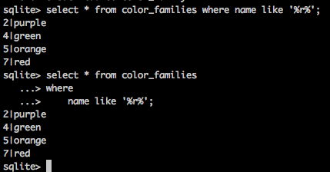
Whitespace
Notes:
Unlike with Python, insignificant whitespace just doesn’t matter.
CHANGE THIS TO BLACK ON WHITE

Slide 22
CREATE
CREATE [TABLE, INDEX, etc] (PROPERTIES)
create table hex_colors (id integer primary key autoincrement, hexvalue text);
create index storage_location_idx on items (storage_location_id);

Slide 23
INSERT
INSERT INTO table_name (column1, column2, column3, column4, …) values (value1, value2, value3, value4);
INSERT INTO ITEMS (name, item_type_id, storage_location_id, hex_color_id) values (“My New Thing!”, 2, 4, 5);

Slide 24
UPDATE
UPDATE table_name SET column1=value1, column2=value2,...columnN=valueN (WHERE columnA=valueA…);
update items set name=”Whoops!”;
update items set name=”New Name” where id = 3;

Slide 25
DELETE
DELETE FROM table_name (WHERE column1=value1…);
DELETE FROM items; # NOOO WHYYYYYYY
DELETE FROM items where id = 1;
DELETE FROM items where name = “Bad Item”;
Notes:
mysql --i-am-a-dummy (doesn’t let you update/delete without a where clause)

Slide 26
SELECT
SELECT column1, column2… FROM table_name WHERE column1=value1,... ORDER BY column1 (asc|desc);
SELECT * FROM items; (all rows)
SELECT * FROM items ORDER BY name desc; (all rows)
SELECT * FROM items limit 1; (1 row)
SELECT * FROM items where id = 1; (maybe not the same row)

Slide 27
SELECT Part Deux - JOINS!
select * from items inner join hex_colors
on items.hex_color_id = hex_colors.id; (oooh now we’re getting fancy!)
select items.name, hex_colors.hex_value from items inner join hex_colors on items.hex_color_id = hex_colors.id where hex_colors.value like ‘%FF%’; (what do you think this returns?)
Notes:
% -> only works with like

Slide 28
Indexes
Nearly all performance and scalability issues can be linked to interactions with indexes.
There is an automatic index on primary key.
How do you know what to add indexes on?
Notes:
The number of unique values in an index is called its cardinality.
Indexes that have a high cardinality relative to the total number of values are more selective, can be queried more efficiently.
Compound indexes
Add indexes on columns that you query often and that have a high cardinality.
Don’t add extra indexes you aren’t using because you have to write for them and you can run into io issues.

Slide 29
Transactions
Groups of statements executed all or none.
BEGIN;
statement1;
statement2;
COMMIT;
Notes:
Allow you to execute groups of statements atomically. CONSISTENCY
Transactions are all or nothing. You create a connection to the db then reuse that connection for a bunch of transactions. state. Lots of connection opening and closing is bad for performance.
Bank example -
balance -= 100
balance += 100
if it errors out you have lost money or added money that isn’t really there. If it is ready in between these two statements you have an incorrect view.

Slide 30
DBs + Python
Plain SQL via Python is more painful than it needs to be. Let’s use an ORM!
Let’s see this in action.
https://github.com/tiny-mouse/daterbasers
Notes:
If you want to play along and you haven’t already checked it out, please do so now.

Slide 31
These are your tables

Slide 32
Disclaimer Number Two
My css/javascript/html skills.
Python Skills
Infra Skills

Slide 33
All Things Fail Sometime
Snapshots/Backups: early and often
Master -> Slave
replication
promotion to master
Security
password storage (hashes need salt, nom)
snapshot/backup storage
Notes:
Replication -
* scale by adding more slaves. Works for most websites. eg. Reddit
* MySQL - essentially sends the statements to the slaves (binlogs)
* Postgres -
password storage - salt + crypto hash

Slide 34
DB++
Migrations
https://pypi.python.org/pypi/alembic
Sharding
Readonly/Readwrite
Notes:
Migrations
What happens when you need something different in your db? When you need a new table or column?
Sharding
What happens when your db has so much data that even with an index performance is terrible? You shard.
RO/RW
Having your application switch between connecting to the master for actions that will alter the database (writes) and
the slave or pool of slaves for actions that will only return data (reads). This is useful for dealing with the bottleneck
on the max number of connections to a single database.

Slide 35
Alternative to RDBMS
NoSQL
MongoDB, Redis
Graph DBs
Notes:
NoSQL - key value storage
Graph DB
- Like Facebook’s graph api.
http://en.wikipedia.org/wiki/Graph_database
who are the friends of my friends?

Slide 36
Questions?

Slide 37
Additional Reading/Resources
Alembic: https://pypi.python.org/pypi/alembic/0.6.3
Sqlalchemy:
http://www.sqlalchemy.org/
MySQL:
- Example DBs: http://dev.mysql.com/doc/index-other.html
- Detailed slides: http://cloud.github.com/downloads/eklitzke/mysql-minutiae/presentation.pdf
Postgres: http://wiki.postgresql.org/wiki/Sample_Databases

